Slide 1
“Why Should I Trust You?”
LIME
Explaing the Predictions
of Any Classifier
付英男

Slide 2

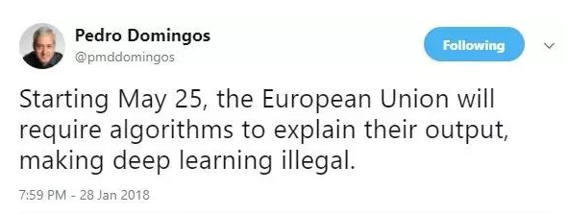
《欧盟一般数据保护条例》
自动决策的可解释权（The Right to Explanation of Automated Decision）指出数据主体有权要求算法自动决策给出解释，有权在对算法决策不满意时选择退出。例如，如果贷款申请人被自动决策拒绝时，有权寻求解释。

Slide 3

美国马萨诸塞州的居民John Gass便深受其害。联邦调查局的反恐识别系统将他误认为是另一位司机，并吊销了他的驾驶执照，于是，他不得不费时费力，让当局相信他不是那名司机。其实，John Cass已经非常幸运。在美国，每周超过1000人被机场使用的算法错误地标记为恐怖分子。
无论是程序错误，还是算法歧视，在人工智能的前沿领域——深度学习中，都变得难以识别。华盛顿特区的Sarah Wysocki是一位被普遍认可的老师，但当2009年政府用一个自动化决定程序来评价教师表现时，她和其他205人因得分不佳被解雇。据称，该决定以少数学生的成绩为依据，可学校始终无法解释为何优秀教师会落得如此下场。华盛顿学校的难题有着深层次原因。

Slide 4
AI
thinking
Think Optimally
Think
Like humans
optimally
like humans
Act Optimally
Act
Like humans
acting

Slide 5
AI
thinking
Machine Learning
Semantic Web
optimally
like humans
Improvisational Robots
Airplane Autopilot
acting

Slide 6
Q: How to expain the predictions?
A:LIME
Local Interpretable Model-Agnostic Explanations
https://github.com/marcotcr/lime/

Slide 7
“Why Shoud I Trust You?”
Explain the Predictions of Any Classifier
Macro Tulio Ribeiro Sameer Singh Carlos Guestrin
University of Washington
2016 KDD

Slide 8
1
Motivation

Slide 9


If the users do not trust a model or a prediction, they will not use it.
Trusting a prediction
A
TRUST
Trusting a model
B

Slide 10
Trusting a precision
LIME, an algorithm that can explain the predictions of any classifier or regressor in afaithful way, by approximating it locally with an interpretable model.
Trusting the model
SP-LIME, a method that selects a set of representative instances with explanations to address the “trusting the model” problem, via submodular optimization.

Slide 11
2
The
Case for Explanations

Slide 12
Trusting a prediction
prior knowledge
Explaning a prediction
模型的可解释性

Slide 13
Explanining a prediction
means presenting textual or visual artifacts that provide qualitative understanding of the relationship between the instance's components(e.g. words in text, patches in an image) and the model's prediction
Explanining predictions is an important aspect in getting humans to trust and use machine learning effectively.

Slide 14
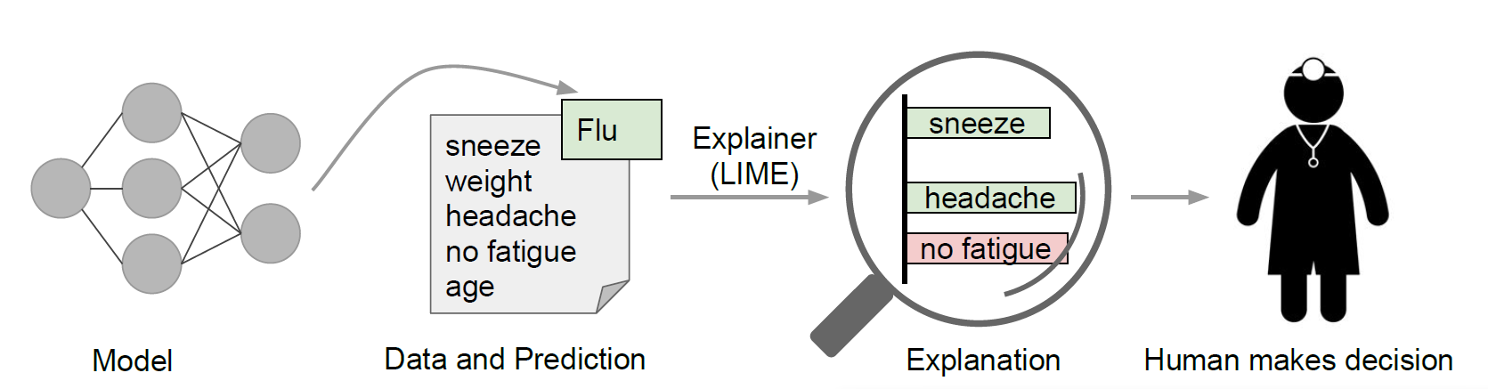
Explanining individual predictions. With these, a doctor can make an informed decision about the model's prediction.

Slide 15

Even when stakes are lower, the user needs to trust the prediction enough to spend money or time on it.

Slide 16
There are several ways a model can go wrong:
—— Overstimate the accuracy
1. Data leakage
2. Irrelevant feature are found to be heavily correlated
with the target class
3. Dataset shift

Slide 17
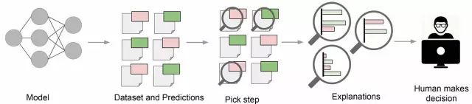

Slide 18
Desired Characteristics For Explainers

Slide 19
1. Interpretable
Interpretability must take into account human limitations. The explanations should be easy to uderstand. Thus, the “inputs variables” in the explanations may be different than the features used by the model.

Slide 20
2. Local fidelity
An explanation to be meaningful it must at least be locally faithful. - i.e. it must correspond to how the model behaves in the vicinity of the instance being predicted.

Slide 21
3. Model-agnostic
An explainer must be able to explain any model, and thus be model-agnostic(i.e. treating the original model as a black box).
4. Global perspective
Building upon the explanations for individual predictions, we select a few explanations to present to the user, such that they are representative of the model.

Slide 22
3
LIME

Slide 23
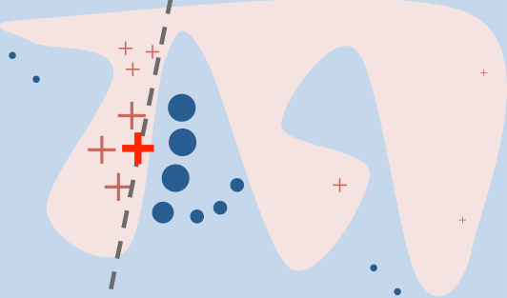

Slide 24
Interpretable Data Representations

Slide 25
Interpretable Data Representations
Interpretable explanations need to use a representation that is understandable to humans, regardless of the actual features used by the model.
Text Classification: a binary vector (presence or absence of a word)
Image Classification: a binary vector (prescence or absence of a contiguous patch of similar pixels)

Slide 26
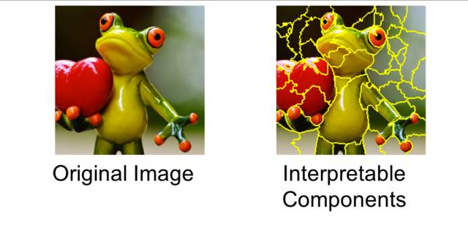
Interpretable Data Representations

Slide 27
Interpretable Data Representations
is the original representation of an instance being explained.
denote a binary vector for its interpretable representation.

Slide 28
Fidelity-Interpretability Trade-off

Slide 29
Fidelity-Interpretability Trade-off
We define an explanation as a model , G is a class of potentially
interpretable models. The input of g is .
linear models (Sparse Linear Model)
interpretable models
decision trees
rule lists

Slide 30
Fidelity-Interpretability Trade-off
We define an explanation as a model , G is a class of potentially
interpretable models. The input of g is .
The model being explained be denoted , is the probability
that x belongs to a certain class.

Slide 31
Fidelity-Interpretability Trade-off
We further use as a proximity measure between an instance z to x.

Slide 32
Fidelity-Interpretability Trade-off
complexity
interpretability
We let be a measure of complexity of the explanation

Slide 33
Sampling for Local Exploration

Slide 34
Sampling for Local Exploration
We sample instances around x' by drawing nonzero elements of x' uniformly sampled.
original
representation
x
sampling
z
interpretable
representation
x'
sampling
z'

Slide 35
Sampling for Local Exploration
We sample instances around x' by drawing nonzero elements of x' uniformly sampled.
original
representation
x
sampling
z
interpretable
representation
x'
sampling
z'
Z

Slide 36
Sampling for Local Exploration
We sample instances around x' by drawing nonzero elements of x' uniformly sampled.
original
representation
x
sampling
z
f(z)
interpretable
representation
x'
sampling
z'
g(z')
Z

Slide 37
Sparse Linear Explanations

Slide 38
original
representation
x
sampling
z
f(z)
interpretable
representation
x'
sampling
z'
g(z')
Z

Slide 39
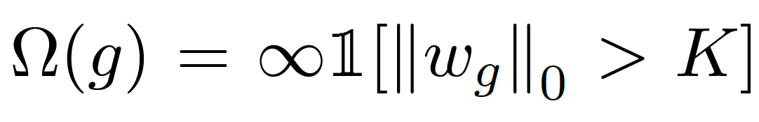

Slide 40
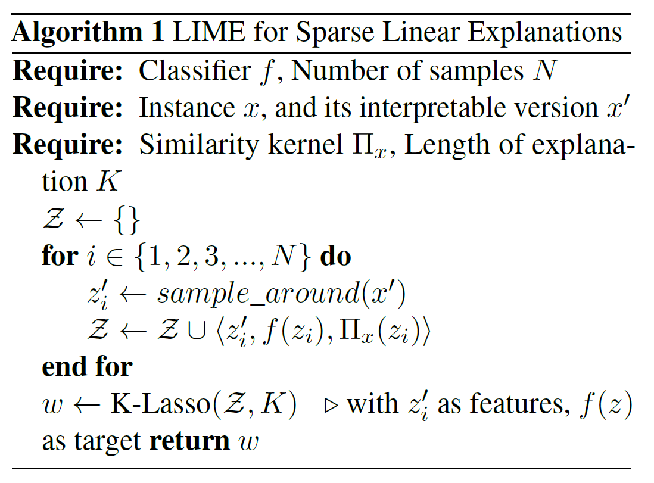

Slide 41
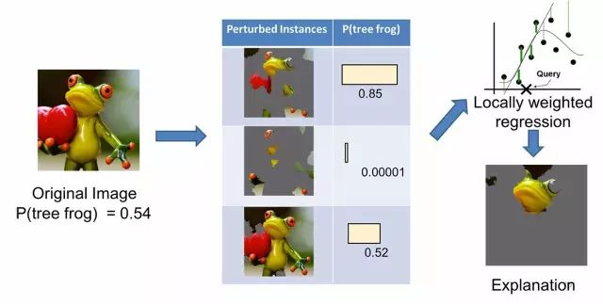

Slide 43
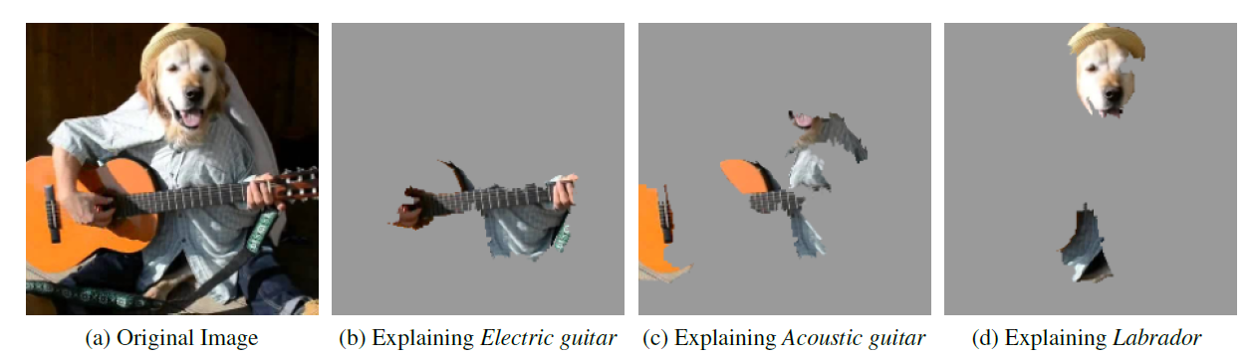

Slide 44
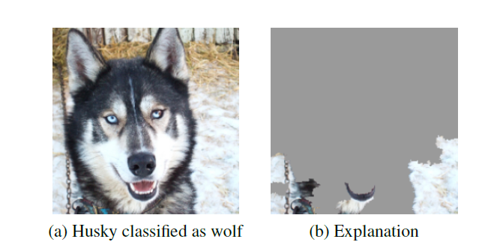

Slide 45
4
Submodular Pick for Explaining Models

Slide 46
Submodular Pick for Explaining Models
Even though explanations of multiple instances can be insightful, these instances need to be selected judiciously, sice users may not have the time to examine a large number of explanations.

Slide 47
Submodular Pick for Explaining Models
B: the number of explanations they are willing to look at in order to undestand a model.
I_{j}: for each component j in W, we let I_{j} denote the global importance.

Slide 48
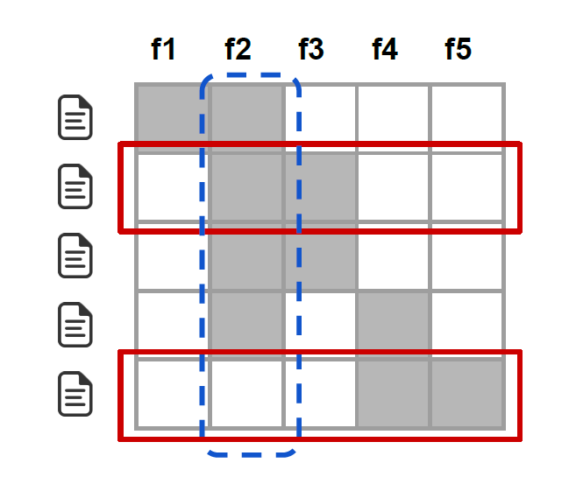
Submodular Pick for Explaining Models
feature: I₂>I₁
B = 2
Rows 2 and 5 would be sele cted

Slide 49
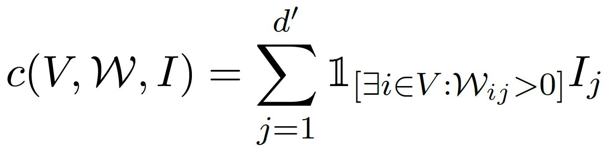
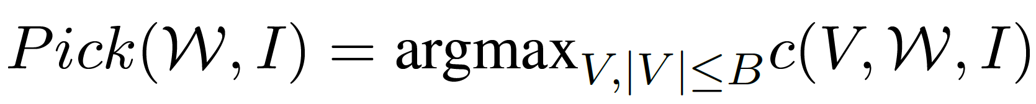
Submodular Pick for Explaining Models

Slide 50
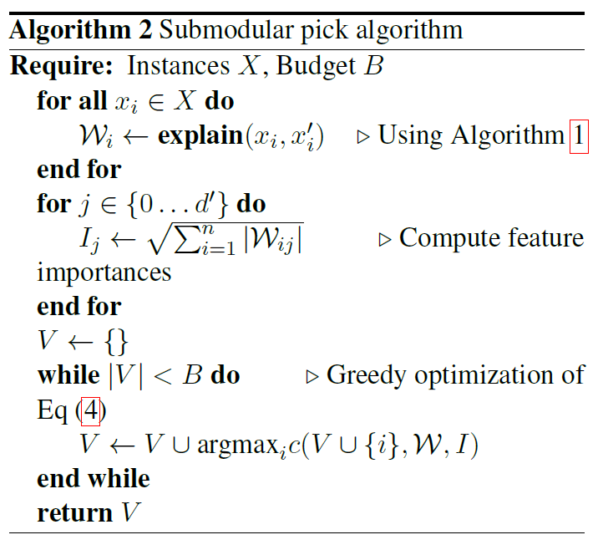
Submodular Pick for Explaining Models

Slide 51
THANK YOU
PPT模板下载：www.1ppt.com/moban/ 行业PPT模板：www.1ppt.com/hangye/
节日PPT模板：www.1ppt.com/jieri/ PPT素材下载：www.1ppt.com/sucai/
PPT背景图片：www.1ppt.com/beijing/ PPT图表下载：www.1ppt.com/tubiao/
优秀PPT下载：www.1ppt.com/xiazai/ PPT教程： www.1ppt.com/powerpoint/
Word教程： www.1ppt.com/word/ Excel教程：www.1ppt.com/excel/
资料下载：www.1ppt.com/ziliao/ PPT课件下载：www.1ppt.com/kejian/
范文下载：www.1ppt.com/fanwen/ 试卷下载：www.1ppt.com/shiti/
教案下载：www.1ppt.com/jiaoan/
字体下载：www.1ppt.com/ziti/

